Slide 1
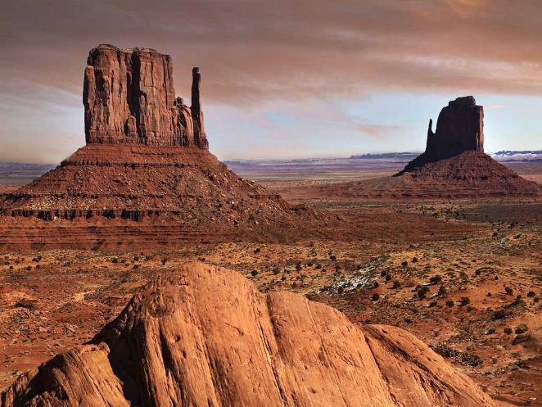
BIOMES

Slide 2
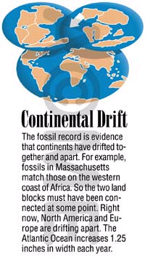
Continental drift - slow motion of continents
Biogeography - study of where organisms live

Slide 3
Dispersal of organisms
Movement of organisms from 1 place to another
Dispersal is usually caused by wind, water or living things
Species that evolve in an area are called native species
Species that are carried to a location are exotic species.

Slide 4
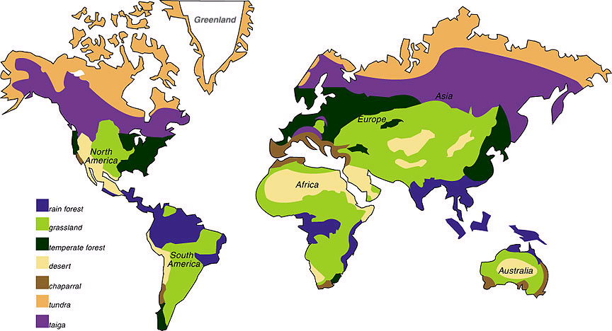
Climate and biomes
The typical weather patterns over a long period of time is the climate.
Biomes are a group of ecosystems with similar climates (temperature and rainfall) and organisms.

Slide 5
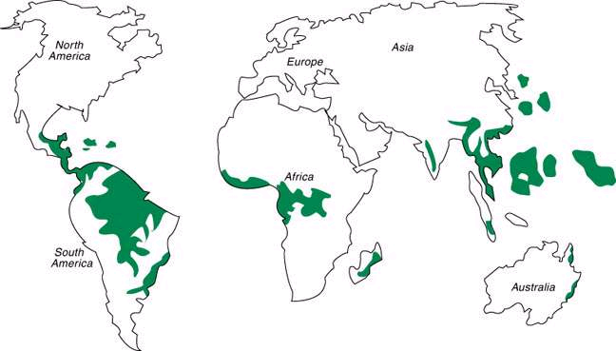
Tropical Rain Forest - found near the equator -

Slide 6
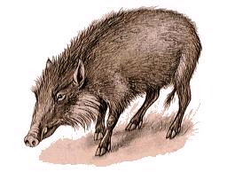
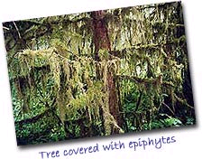
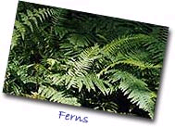
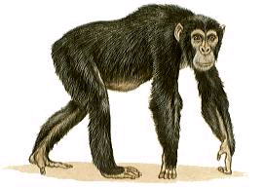
Precipitation: 125 -166 cm
Temperature: 20⁰ C – 34⁰ C
Tropical Rain forests have many species of plants and animals

Slide 7
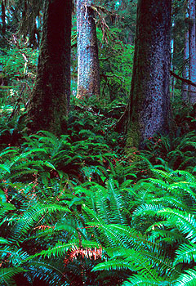
Precipitation: 250 – 350 cm
Temperature: 0⁰ C - 20⁰ C
Temperate Rain Forest - Northwestern U.S., Chile, South Australia - more moderate temperatures, but still have a lot of rain.

Slide 8
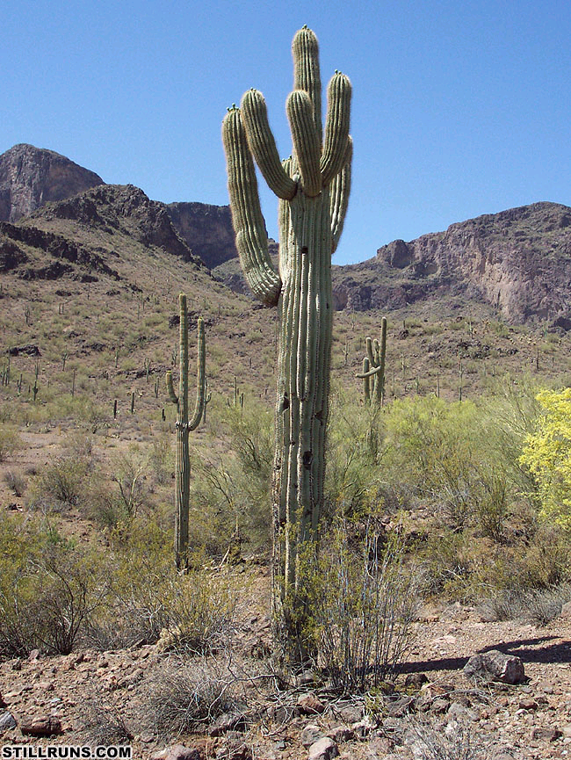
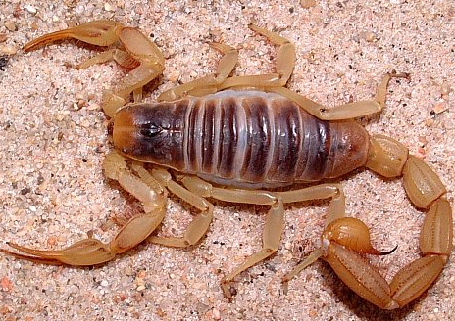
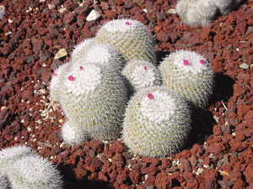
Desert Biomes
Precipitation: 15 – 26 cm
Temperature: -2⁰ C - 49⁰ C
In the Desert Biome, plants (cactus) have the ability to hold water for later use and most animals (scorpion) are nocturnal.

Slide 9
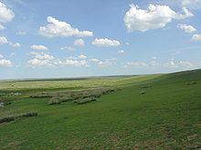
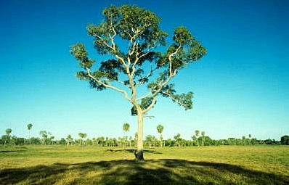
Grassland
Precipitation: 25.4 – 72.6 cm
Temperature: -40⁰ C - 21⁰C
Grasslands receive more rain than the desert - enough to support grasses and bushes, but not enough to support trees.
Savannas
Precipitation: 10 – 64 cm
Temperature: 21⁰ C
Savannas are like the grasslands except that they do receive enough rain to support small trees.

Slide 10
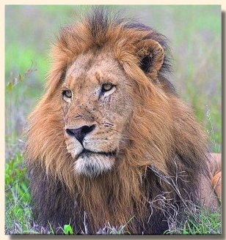
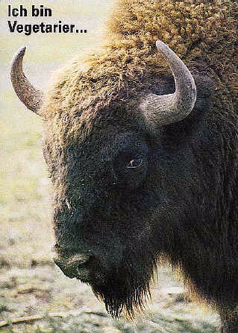
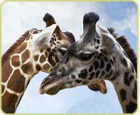
Animals that appear in both include: bison, antelopes, giraffes and kangaroos.

Slide 11
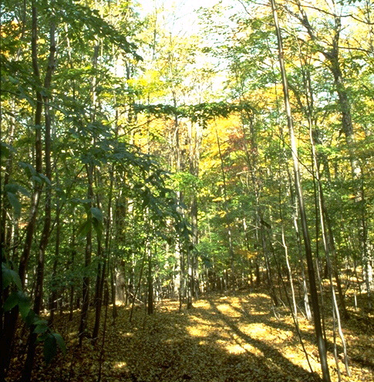
Deciduous Forest
Precipitation: 76 – 152 cm
Temperature: 10⁰ C
The weather in this area
changes with the seasons.
It becomes very cold in
the winter and hot in
the summer. There is
enough rainfall to support
large trees.

Slide 12
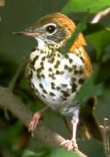
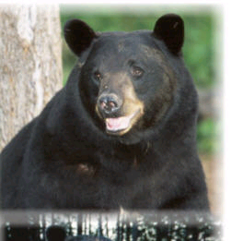
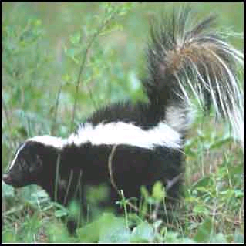
Trees in this biome drop their leaves in the fall and new ones sprout each spring.
Animals include deer, skunks, insects and bears.

Slide 13
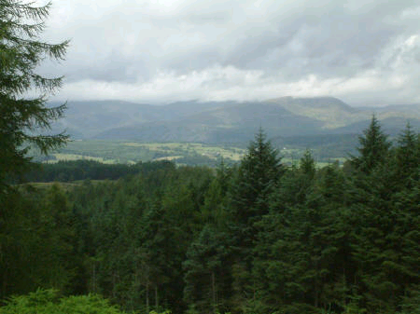
Coniferous Forest
Precipitation: 30-85 cm
Temperature: -54⁰ C - 21⁰ C

Slide 14
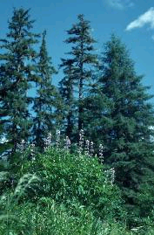
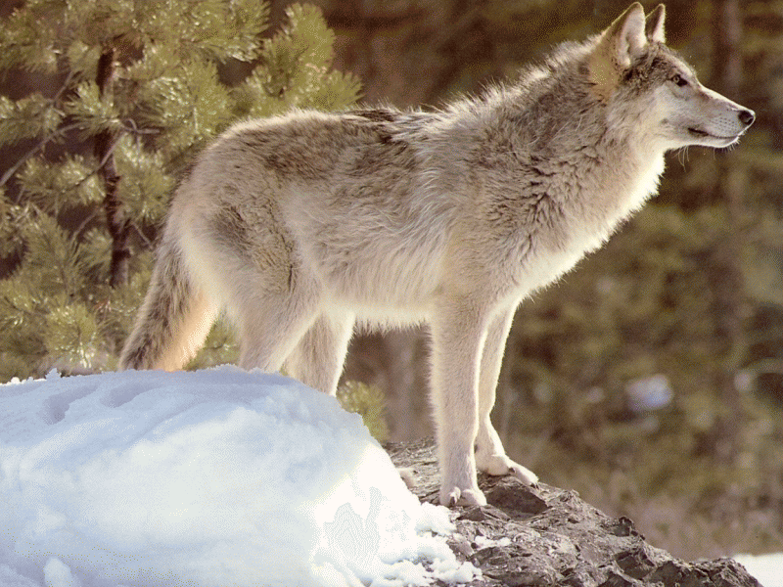
Coniferous trees make-up most of the plant life here.
Animals in this biome include deer, elk, moose and wolves.

Slide 15
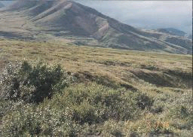
Tundra
Precipitation: 16 – 25 cm (mostly snow)
Temperature: -94⁰ C - 16⁰ C
The land here is very cold and dry. It has
a permanent layer of frost all year (permafrost).
Plants include mosses, shrubs and willow trees.
Animals such as wolves, foxes, hares and caribou grow thick fur during the winter to keep warm.

Slide 16
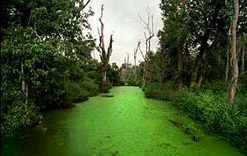
Freshwater Biomes
Algae is the most abundant form of plant life in the water biomes because sunlight has to be there in order for photosynthesis to occur.
Freshwater biomes are divided into 2 groups: ponds and lakes and streams and rivers

Slide 17
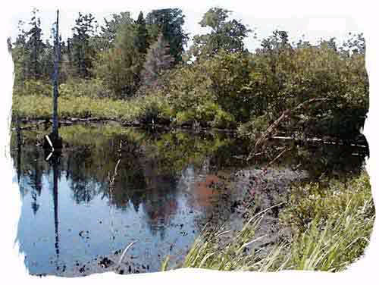
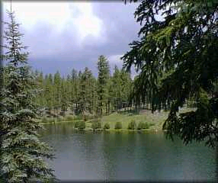
Ponds and Lakes
Lakes are deeper than ponds. Sometimes ponds are shallow enough for sunlight to reach the bottom which lets plants grow.

Slide 18
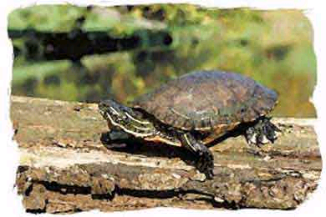
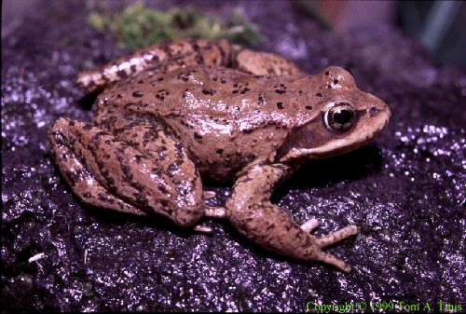
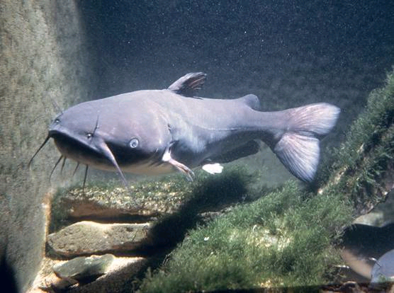
Animals include those that live on the shore (snails and frogs) and those that live in the water (catfish).

Slide 19
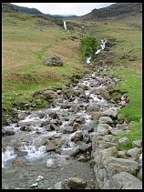
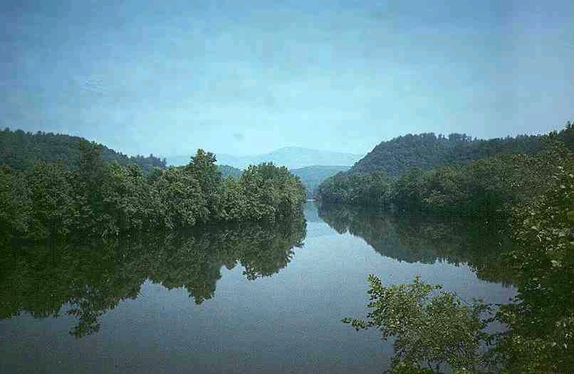
Streams and Rivers
The water runs fast in these areas. Few plants can survive in the fast current, so consumers must rely on leaves and seeds that fall in.

Slide 20
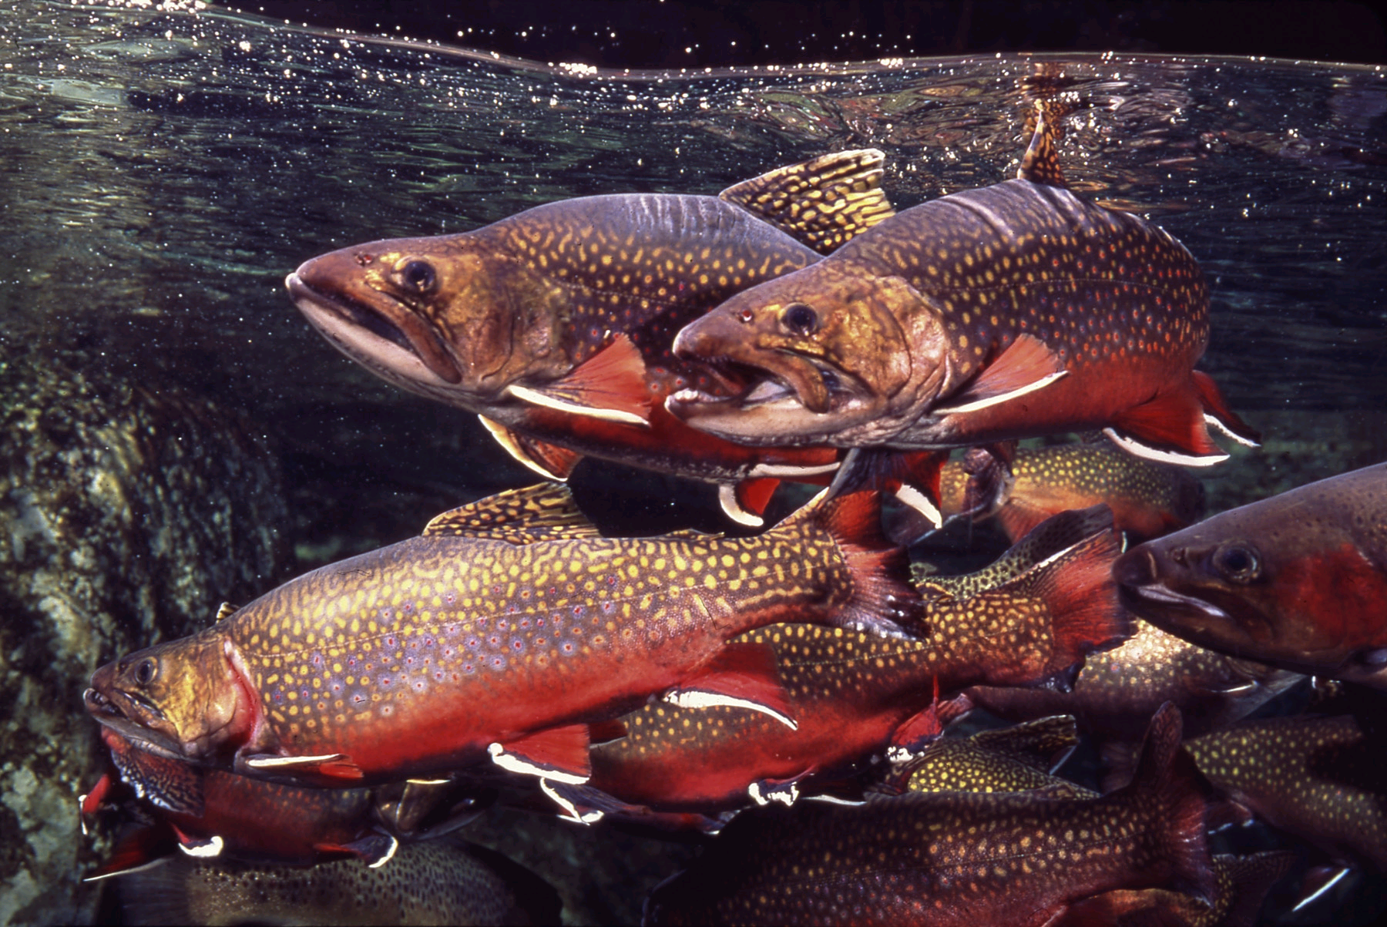
Animals have to be strong enough to fight the current (trout) or have to be able to cling to rocks.

Slide 21
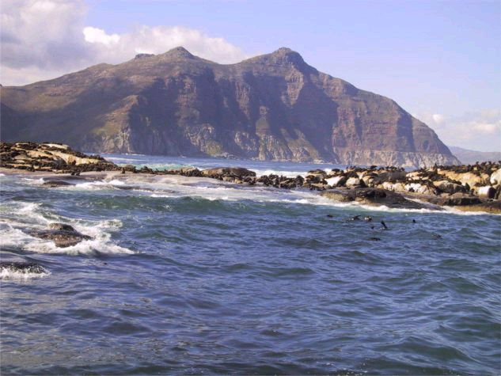
Marine Biomes
Divided into 4 sections: Estuaries, Intertidal Zone, Neritic Zone, and Surface/Deep Zone.

Slide 22
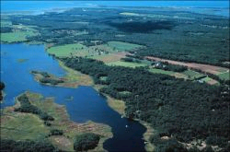
Estuaries
This is where the water from the rivers and streams runs into the ocean, making a mixture of fresh and salt water.

Slide 23
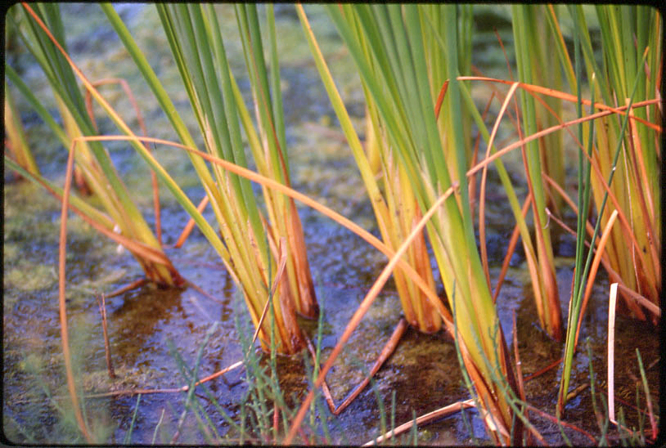
Since sunlight is plentiful in this area, so is the plant life. An example is marsh grass.
Animals in this area include crabs, worms, oysters and fish.

Slide 24
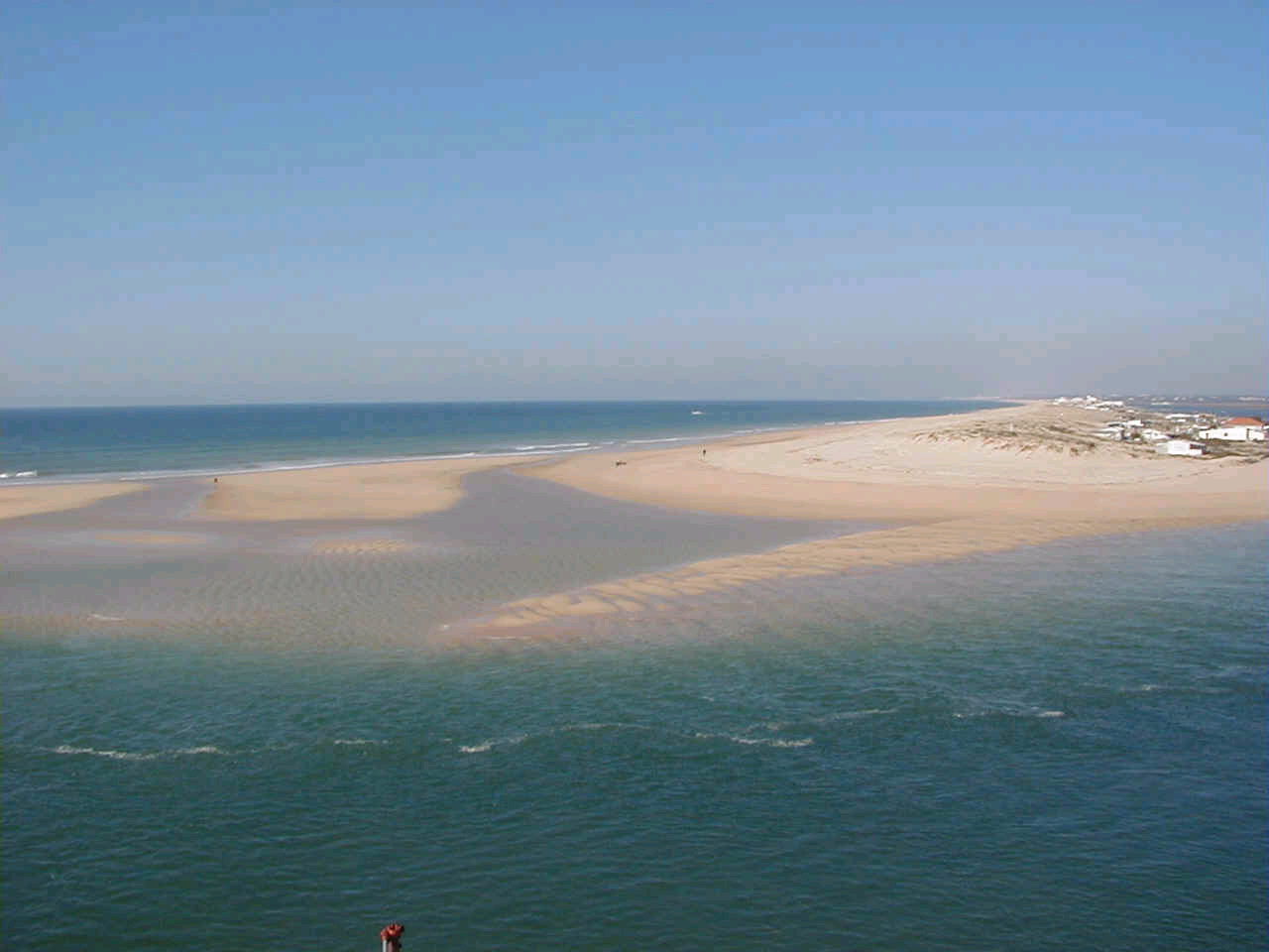
Intertidal
Includes area from high-tide line to low-tide line.

Slide 25
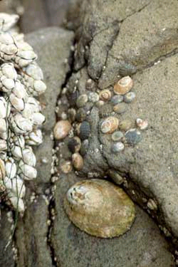
Organisms must be able to take the pounding sea and changes in temperature.
Examples include barnacles, clams and crabs.

Slide 26
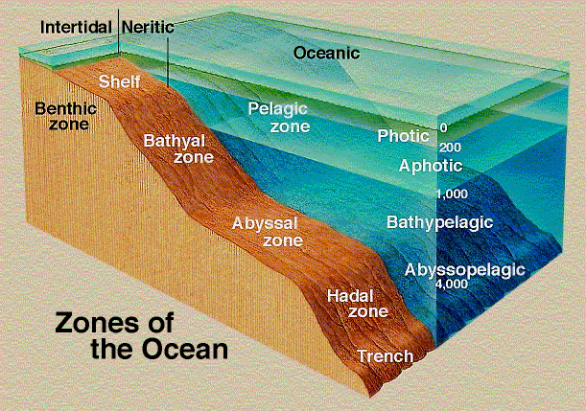
Neritic Zone
Area from low-tide level to end of
continental shelf. Water is fairly shallow, so photosynthesis can occur.
Many types of fish and plant life.

Slide 27
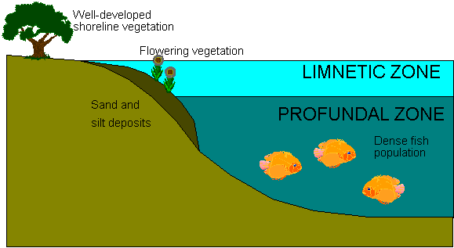
Surface Zone(Limnetic)
The top few meters of the open ocean where light can still pass through.

Slide 28
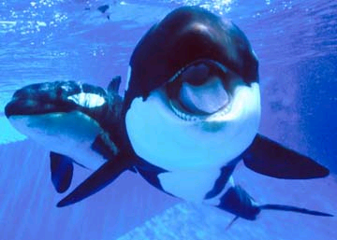
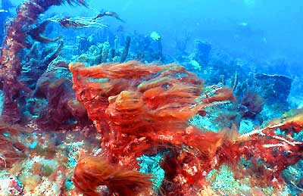
Algae is the main form of plant life and many animals such as tuna and whale.

Slide 29
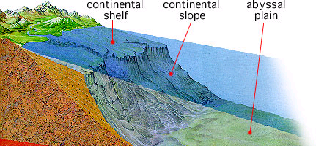
Deep Zone
This is the lower part of the deep ocean where light does not reach.

Slide 30
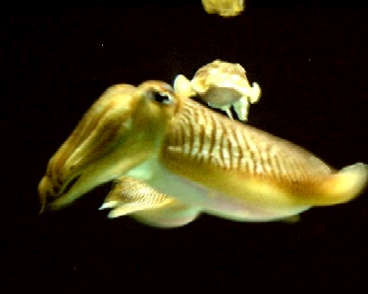
The animals there live on the remains of other organisms that sink to the ocean floor. Squid live in this area.

Slide 31
Symbiosis

Slide 32
Our goal for today is to answer these questions:
What is symbiosis?
What are the different kinds of symbiosis?
What are some examples of symbiosis?

Slide 33
What is symbiosis?
the act of living together

Slide 34
Symbiosis
What it means:
Two organisms that live together
Temporarily or for a longer time
At least one of the organisms
benefits from the relationship

Slide 35
What are the different kinds of symbiosis?
Mutualism
Commensalism
Parasitism
both organisms benefit
one organism benefits
one organism benefits
one organism is unaffected
one organism is harmed

Slide 36
Mutualism
Organism One Organism Two

Slide 37
Commensalism
Organism One Organism Two

Slide 38
Parasitism
Organism One Organism Two

